Slide 1
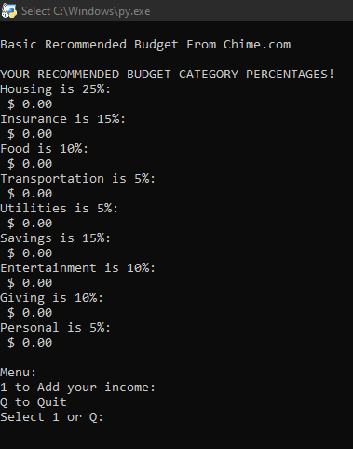
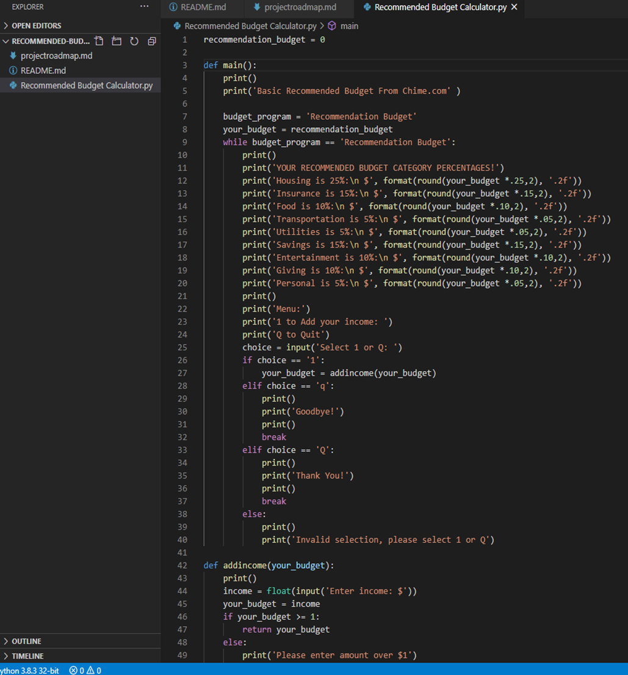
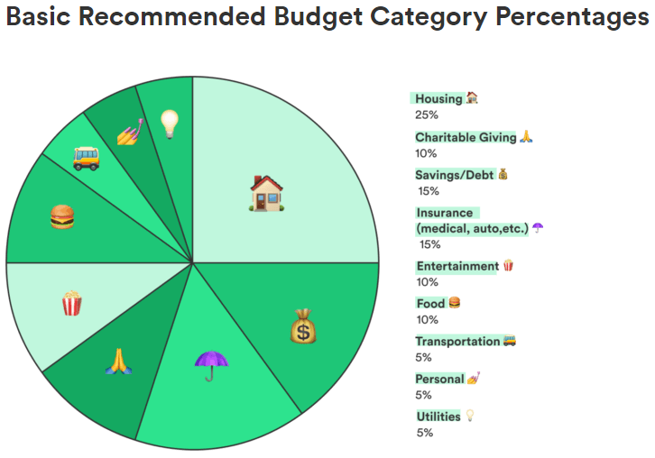
Recommend Budget Calculator
Project by Van Luong
“Professional suggested budgeting made easy for you!”

